Slide 1
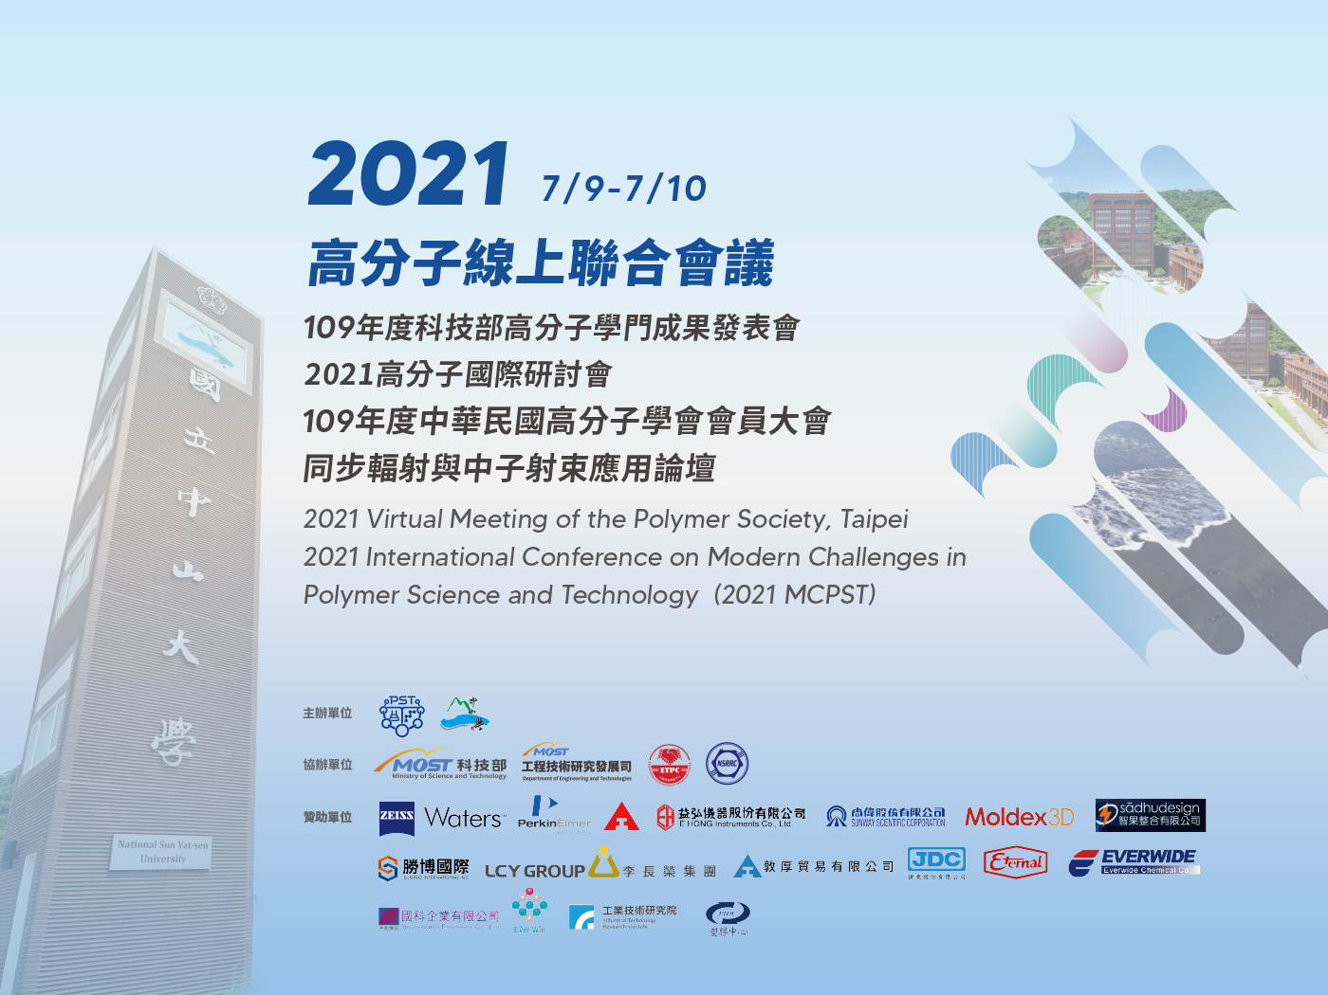

Slide 2
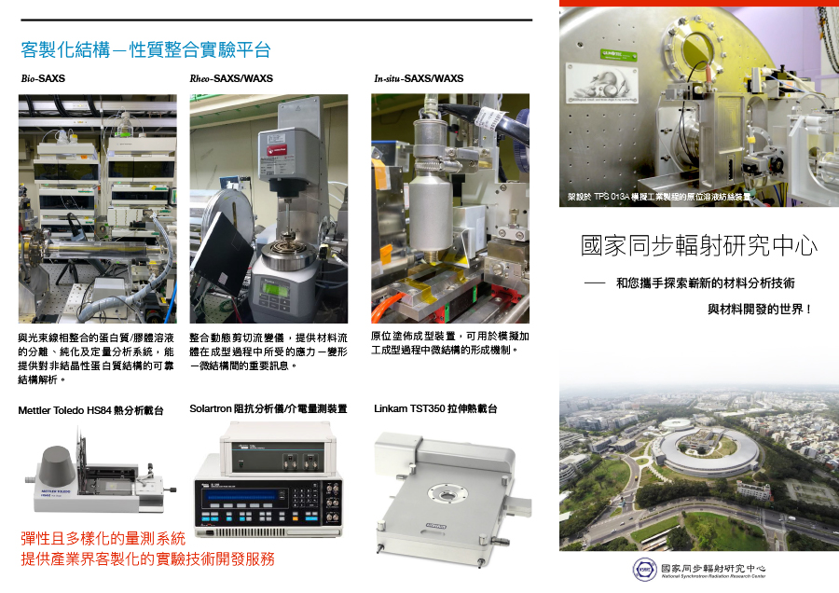

Slide 3
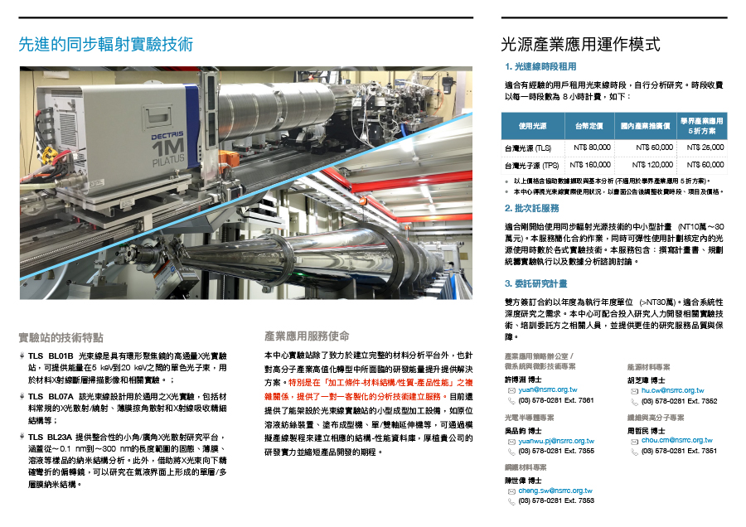

Slide 4
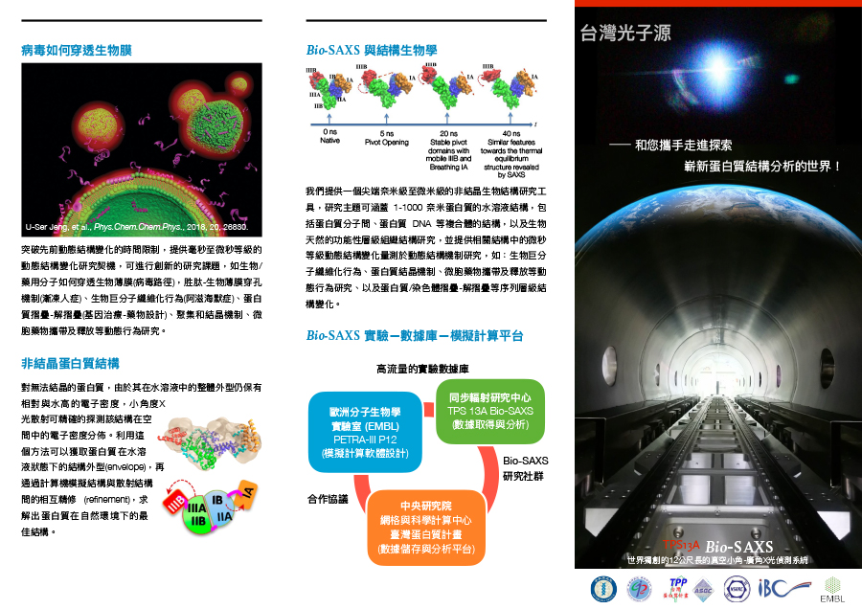

Slide 5
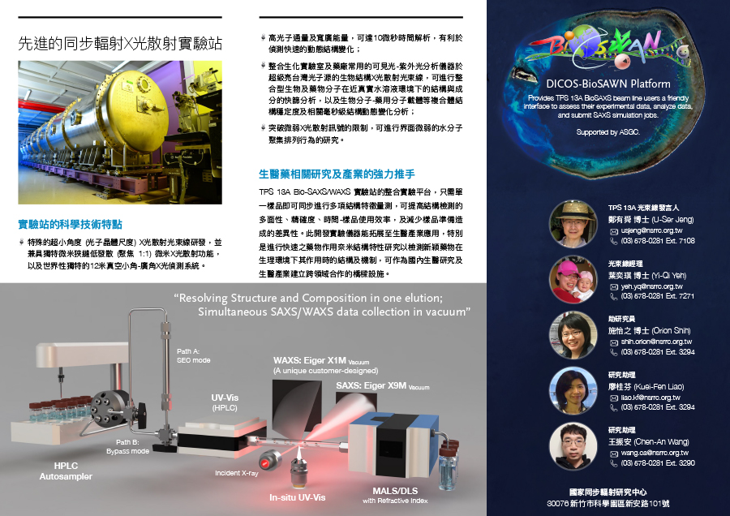

Slide 6
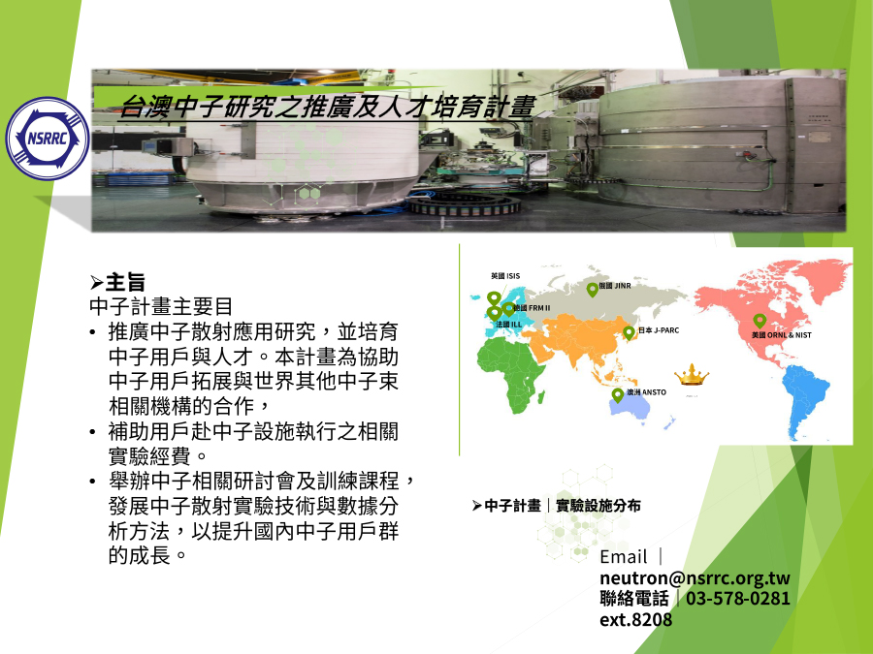

Slide 8




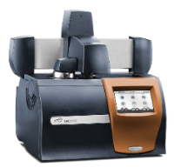
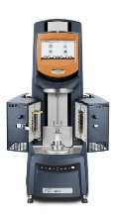
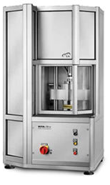
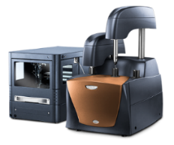
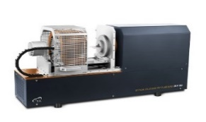
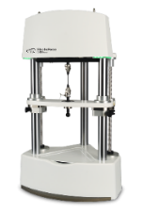
Thermal Analysis
Measures material properties as a function of temperature. Heat flow, weight, mechanical.
Rheology
Measures the flow and deformation of materials. #1 in traditional rheometer market.
Microcalorimetry
Thermal analysis for the life sciences. Biomolecular binding and stability.
TPP - High Temp Thermal Analysis
Measures material properties to temperatures as high as 2800 degrees Celsius.
Mechanical Testing
Revolutionary electromagnetic mechanical test instruments capable of up to 15,000N force.
美商沃特斯國際股份有限公司台灣分公司-TA儀器
Tel +886.2.2563 8880 • Fax +886.2.2563 8870 •
http://www.tainstruments.com

Slide 9
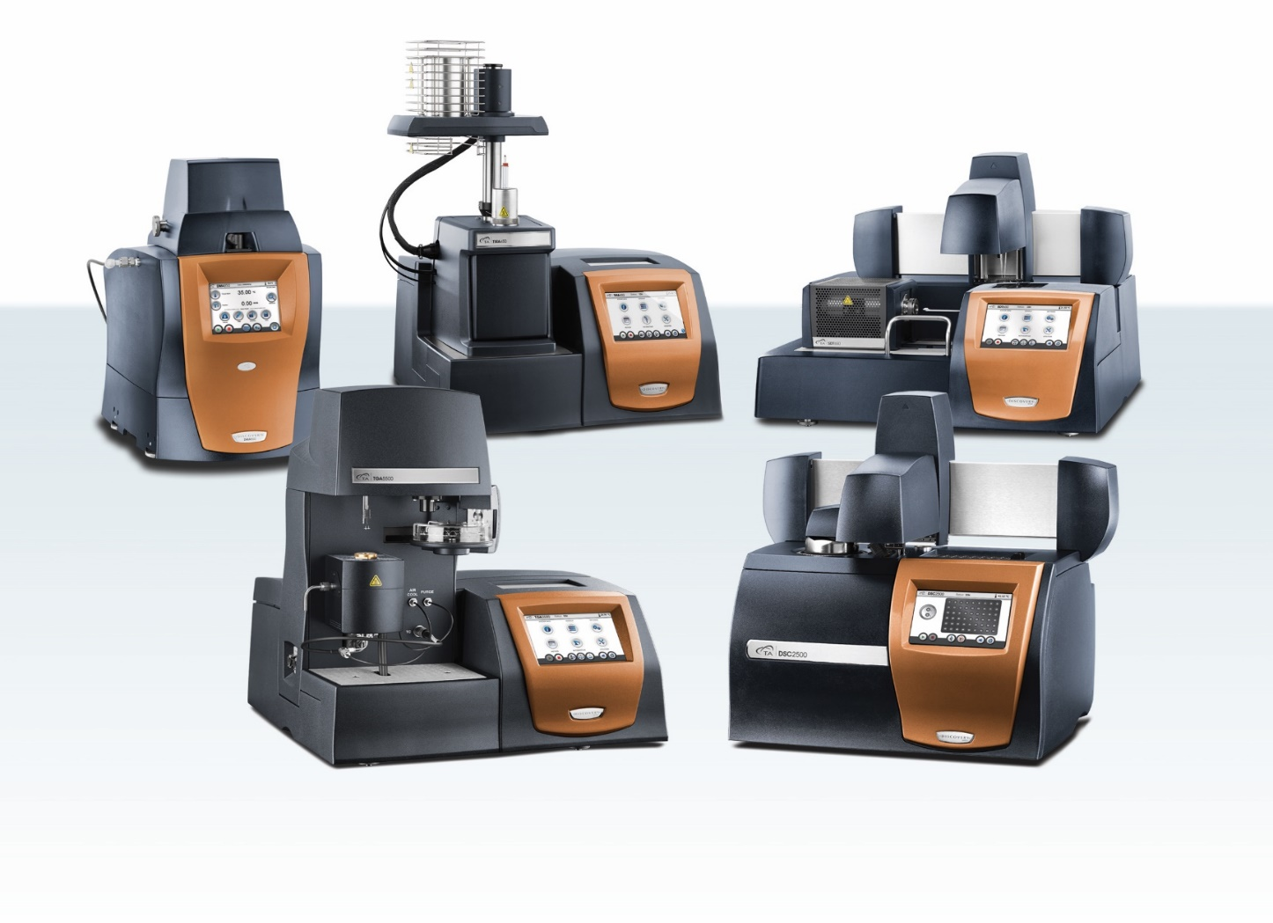
Thermal Analysis
SDT
DMA
TMA
TGA
DSC
美商沃特斯國際股份有限公司台灣分公司-TA儀器
Tel +886.2.2563 8880 • Fax +886.2.2563 8870 •
http://www.tainstruments.com

Slide 11
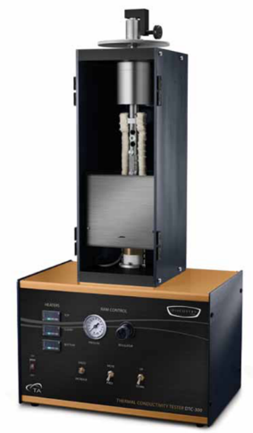
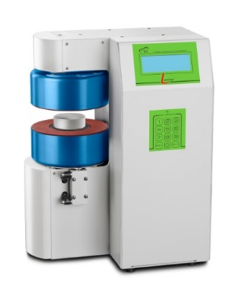
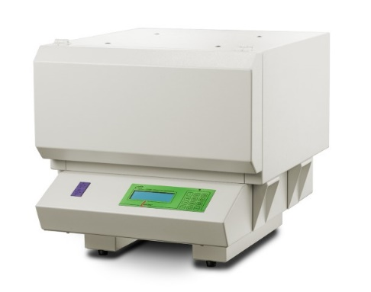
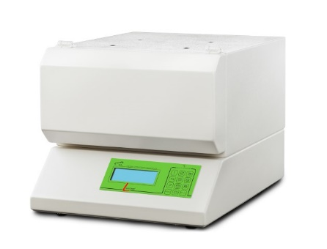
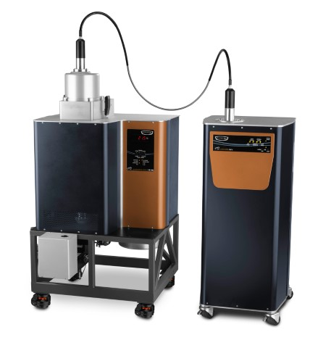
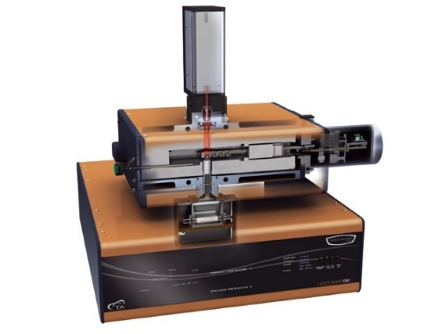
Thermal Physical Property Products
Thermo-conductivity
DTC300
FOX50
FOX200
FOX 314
Thermo-conductivity/Thermo-diffusivity
DXF500/900
DLF1600/2800

Slide 12

Discover the unknown with ultimate imaging and effortless analytics.

Slide 13
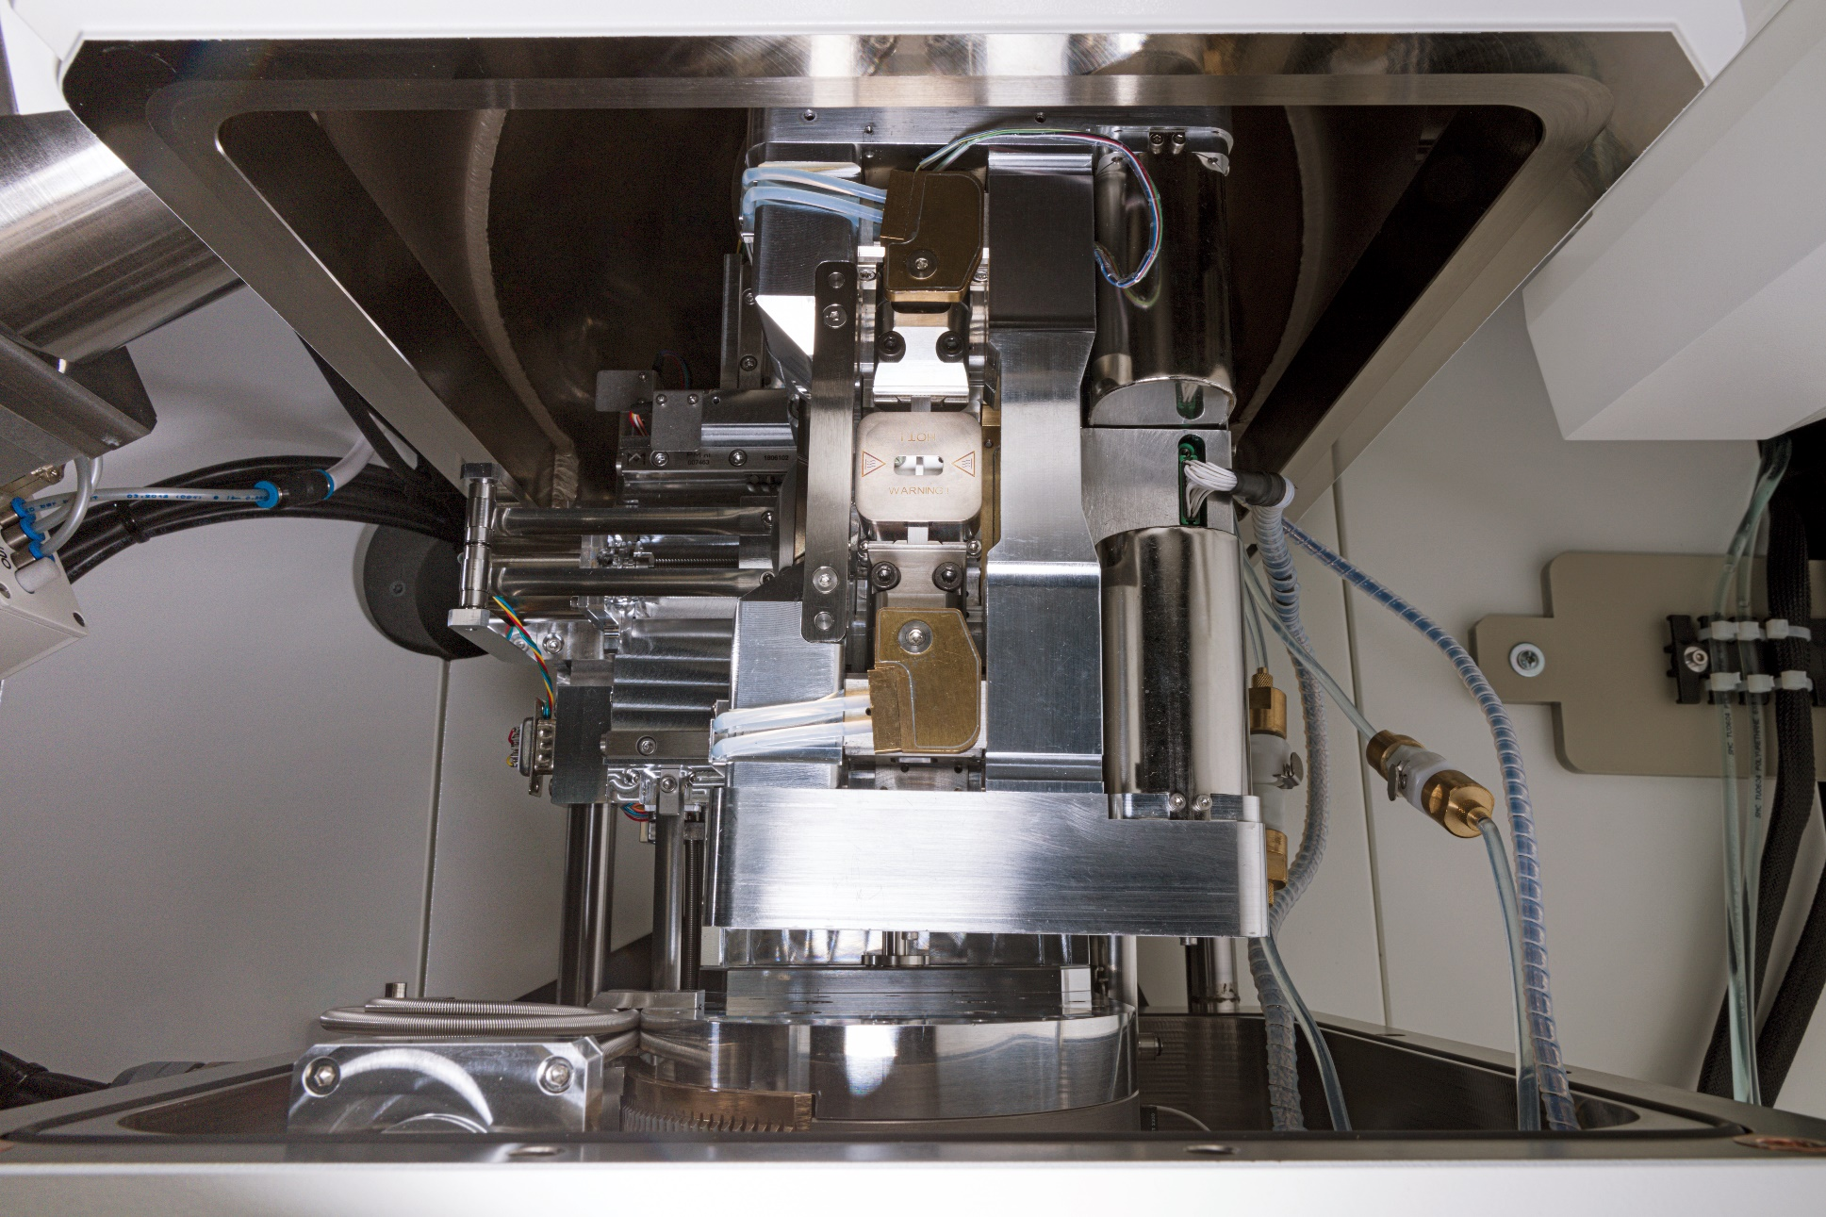
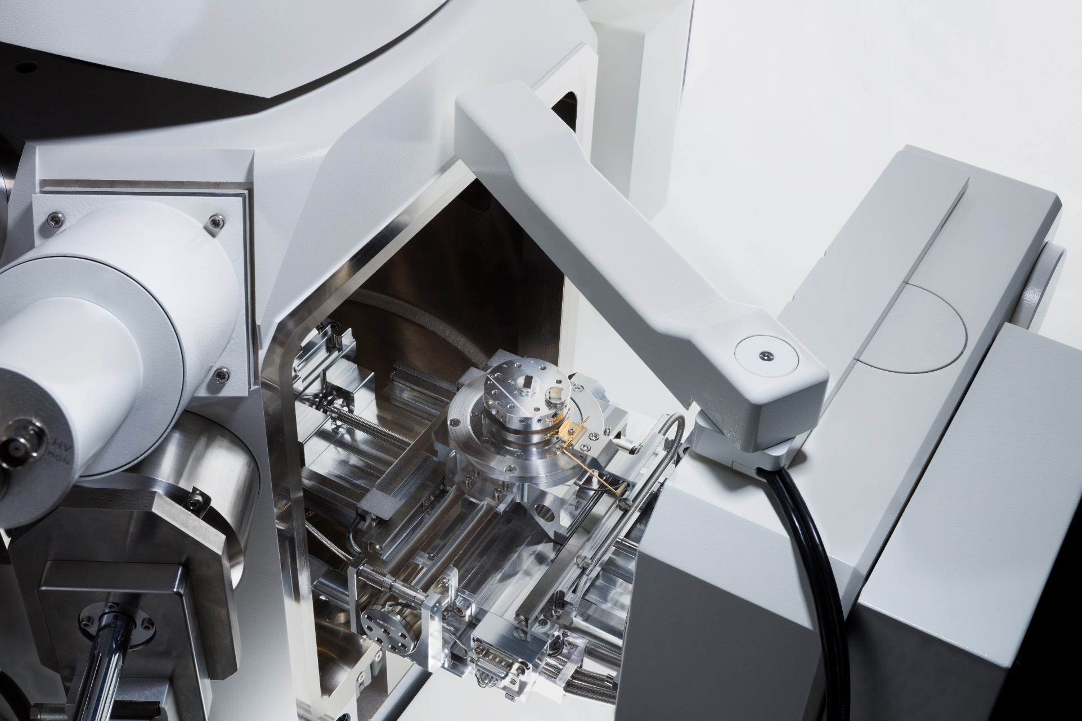

Slide 14
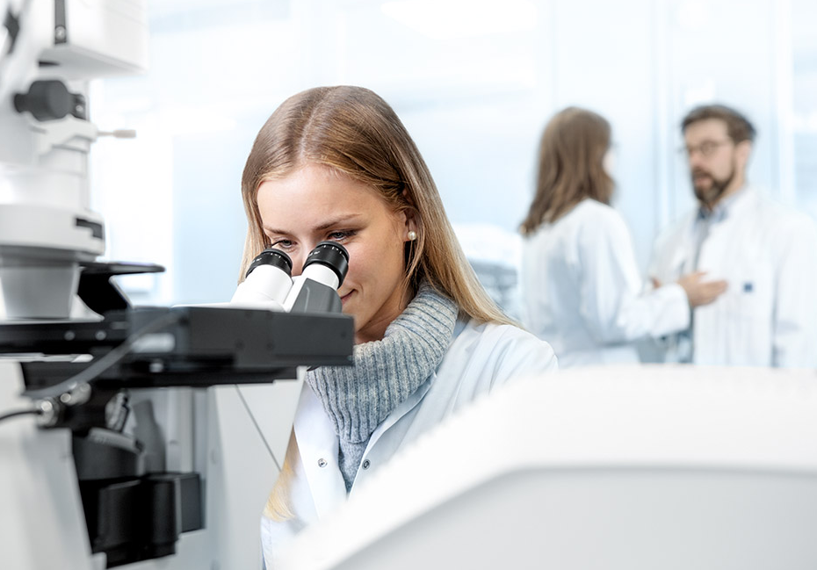



The most advance technology for the highest quality data.
Microscopy
Facebook
Instagram
Follow Us !!

Slide 15

Discover the Unknown with Ultimate Imaging and Effortless Analytics.
STEM micrograph of the high-Mw PS-P2VP bulk sample cast from DCM, revealing the gyroid microstructures.
SEM micrograph of the high-Mw PS-P2VP bulk sample cast from DCM. The bulk sample was subjected to selective swelling in ethanol which converting the P2VP domains into pores.
FESEM micrographs of the porous TiO2-network film.

Slide 16
Discover the Unknown with Ultimate Imaging and Effortless Analytics.
FE-SEM micrograph of the high-Mw PS-P2VP film sample as-spun from TCE solution. The film was subjected to selective swelling in ethanol which converting the P2VP domains into pores.

Slide 17
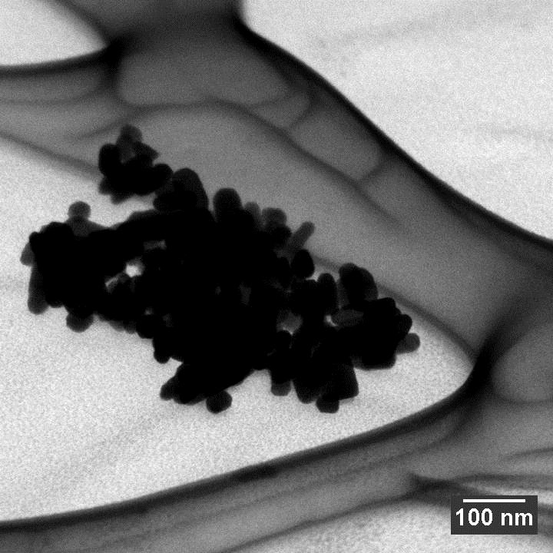
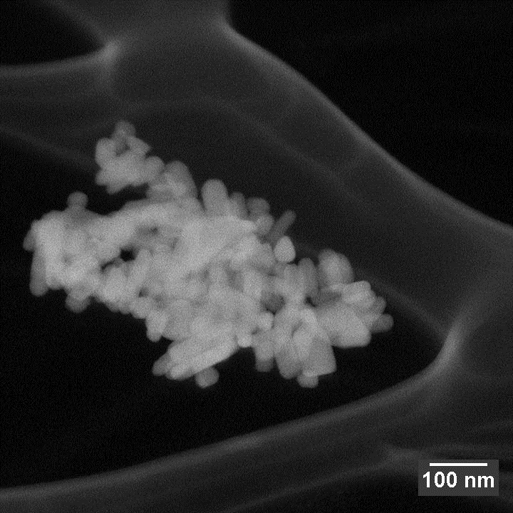
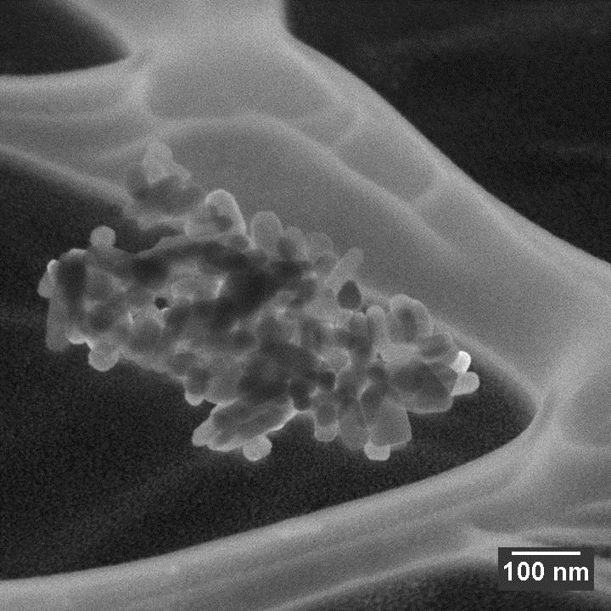
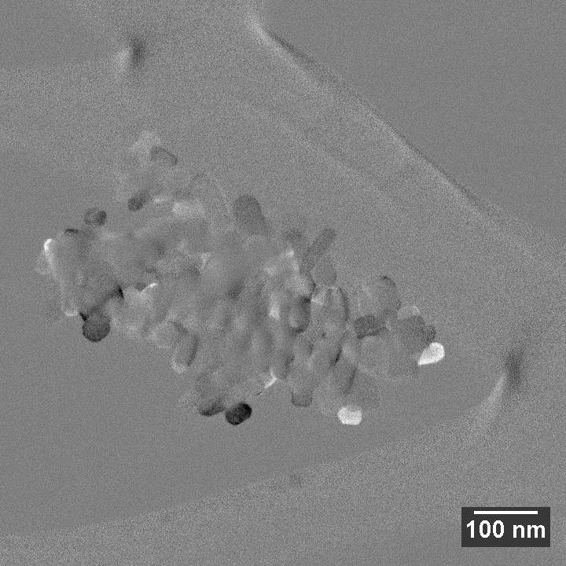
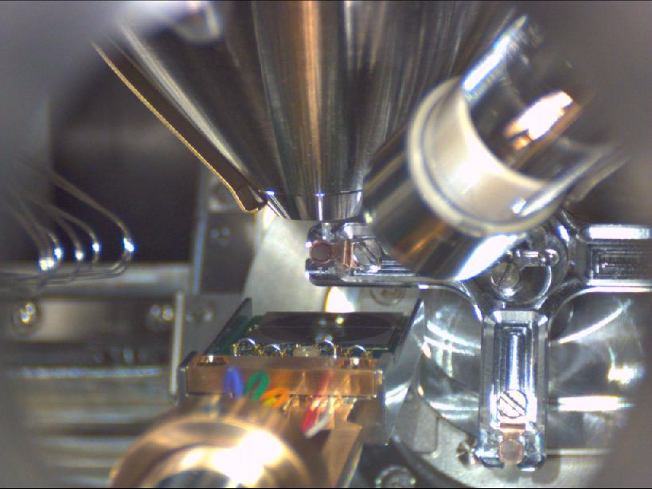
3D STEM (Voxel Dimension 2.0nm)
ZnO nano particles, 25kV STEM
STEM sample holder with rotation / tilt capability:
  Rotation around the STEM detector (> 180°)
  Potential for 3D reconstruction
  High capability for tuning channeling contrast
BF
ADF
DF
ODF

Slide 18


Slide 19

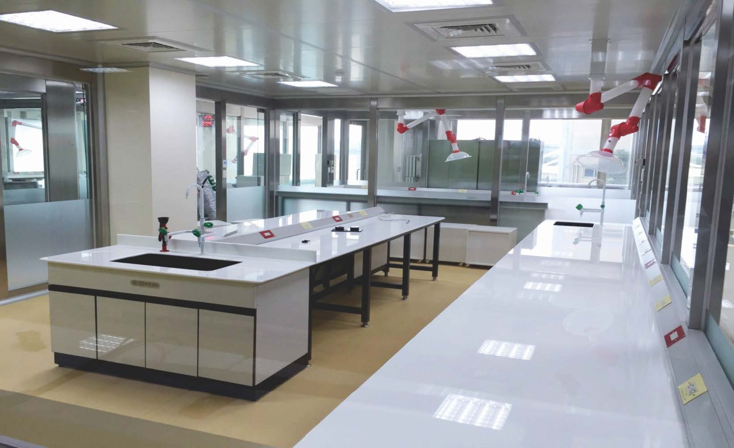
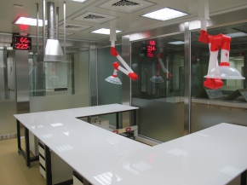
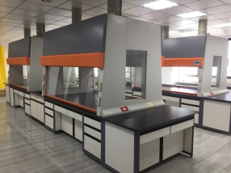
★服務項目
實驗室設備整體規劃設計製作
排煙櫃、實驗桌、防爆櫃等產品
空汙廢氣處理設備設計製作
無塵室設備整體規劃設計製作
電子及生技實驗室等相關產品
實驗室工安等相關產品
實驗室氣體管線設計規劃施工
特殊調壓閥、針閥及相關產品
不鏽鋼相關產品設計及製作

Slide 20
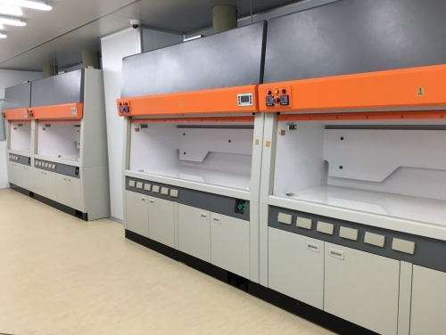
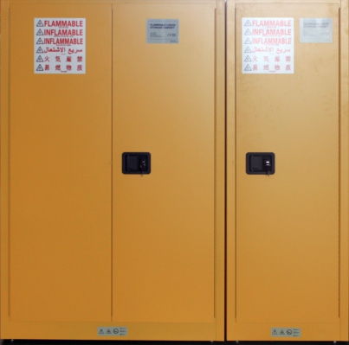
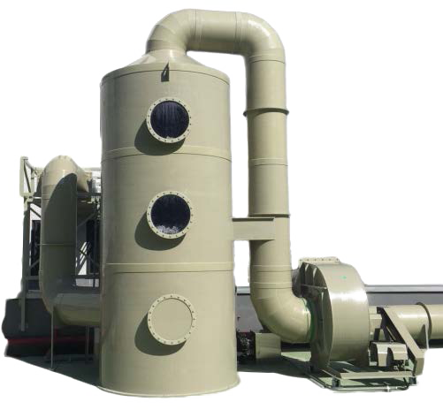
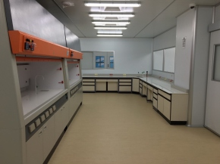
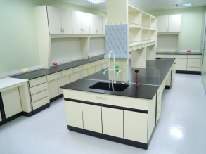
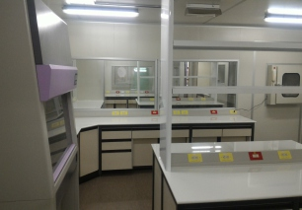

★實驗室設計規劃
專利N2滅火型排煙櫃
專利字號 : 新型第M 3 7 3 4 5 6
安全儲放櫃
E N 1 4 4 7 0 - 1為檢測標準C E認證
廢氣⽔洗塔
814高雄市仁武區永宏巷39-8號
TEL:07-3527599 FAX:07-3515099
E-MAIL : join.j500923@msa.hinet.net
www.ever-win999.com.tw

Slide 21
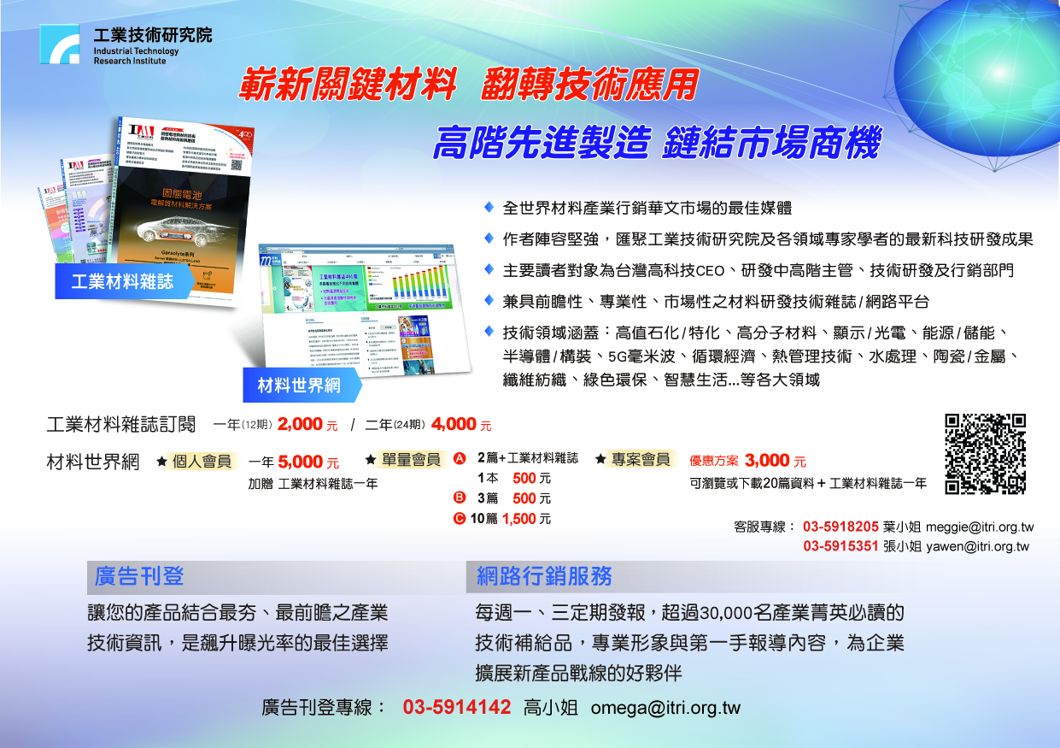

Slide 22

請依照此大小編輯廣告頁
高：14.8cm
寬：21cm

Slide 23
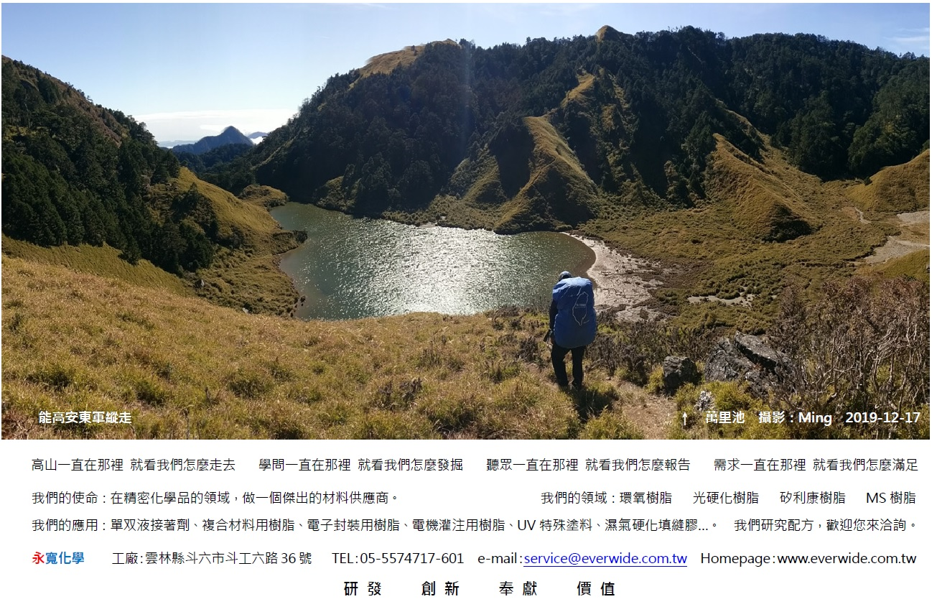

Slide 24

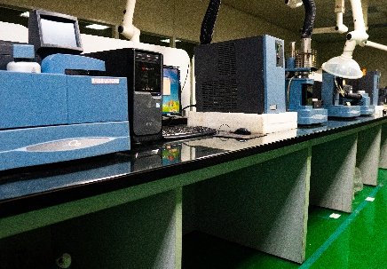
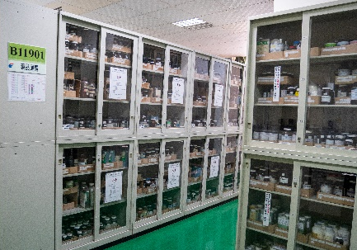
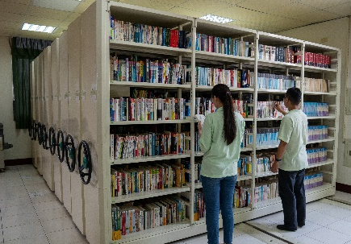
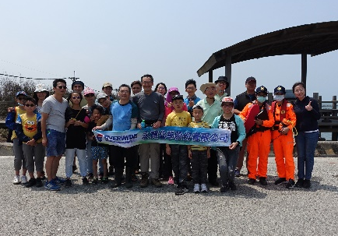
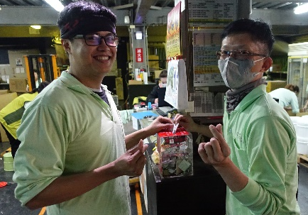
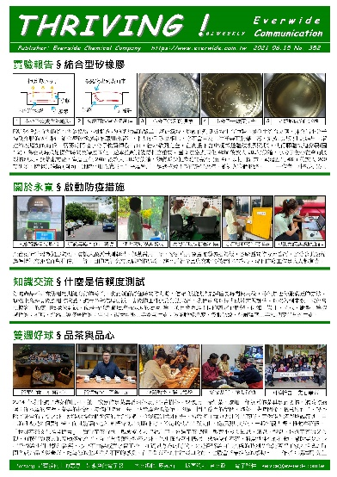
專業研發，儀器檢驗
多元原料，樣品庫房
多類書籍，收藏圖書
海岸認養，淨灘活動
推行公益，愛心票箱
電子刊物，知識分享

Slide 25


Slide 26


Slide 27
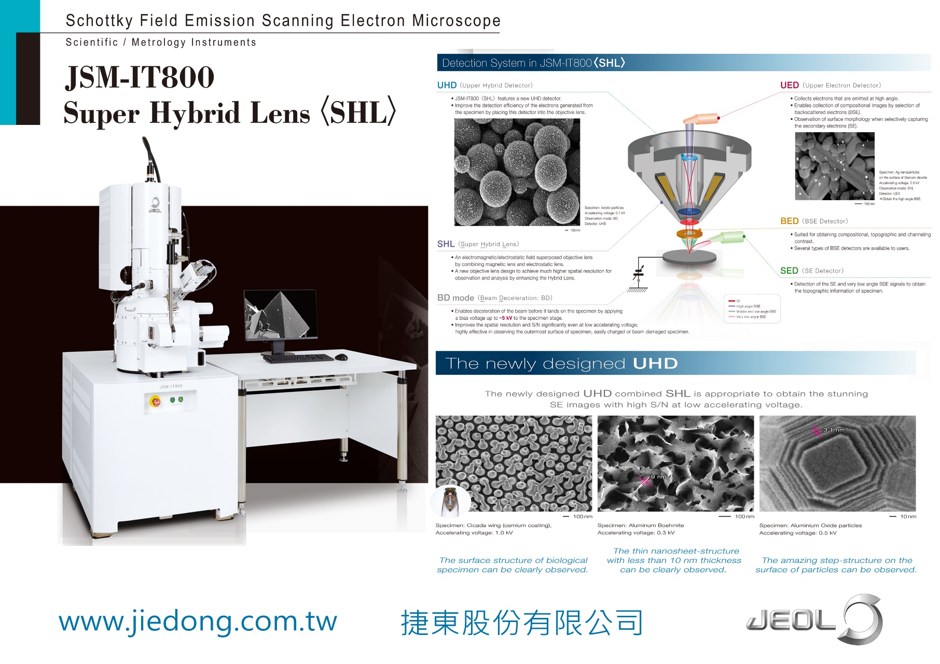

Slide 28
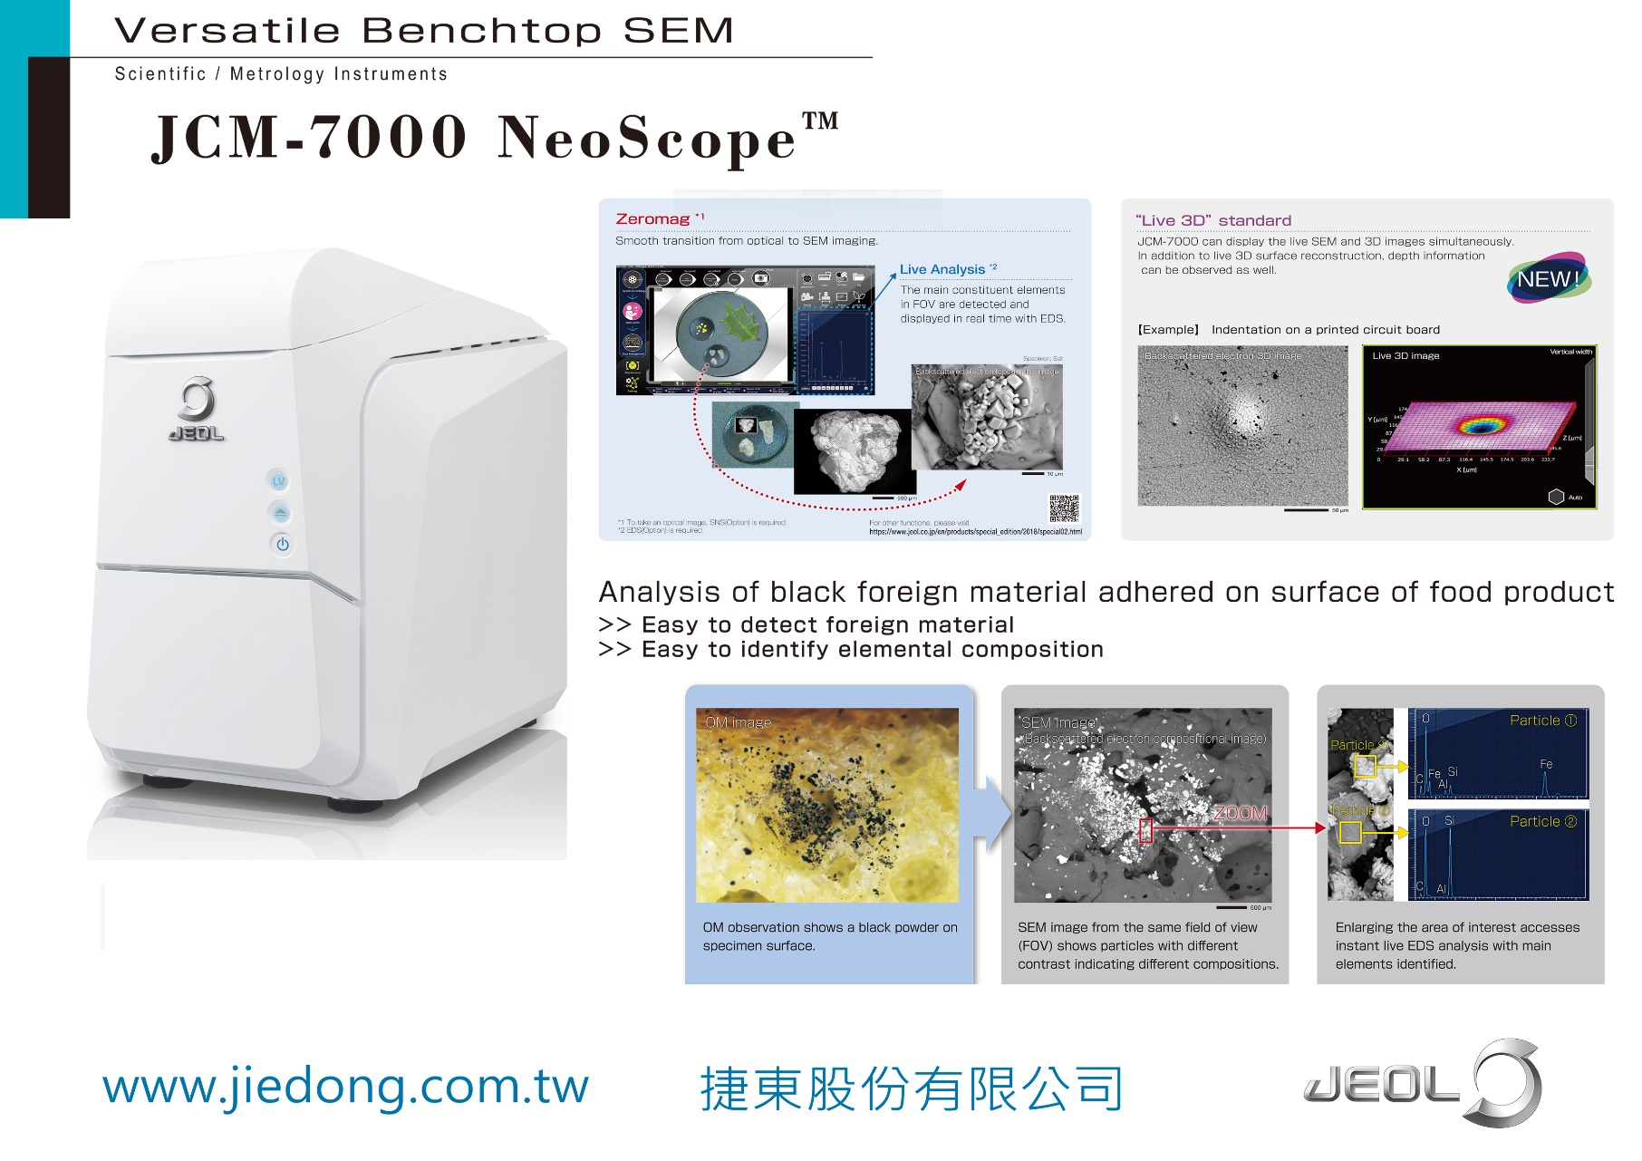

Slide 29


Slide 30
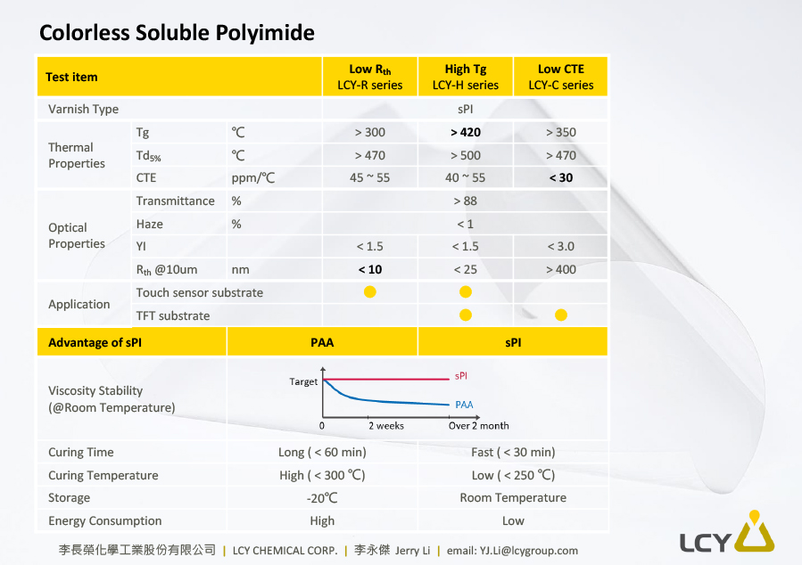

Slide 31
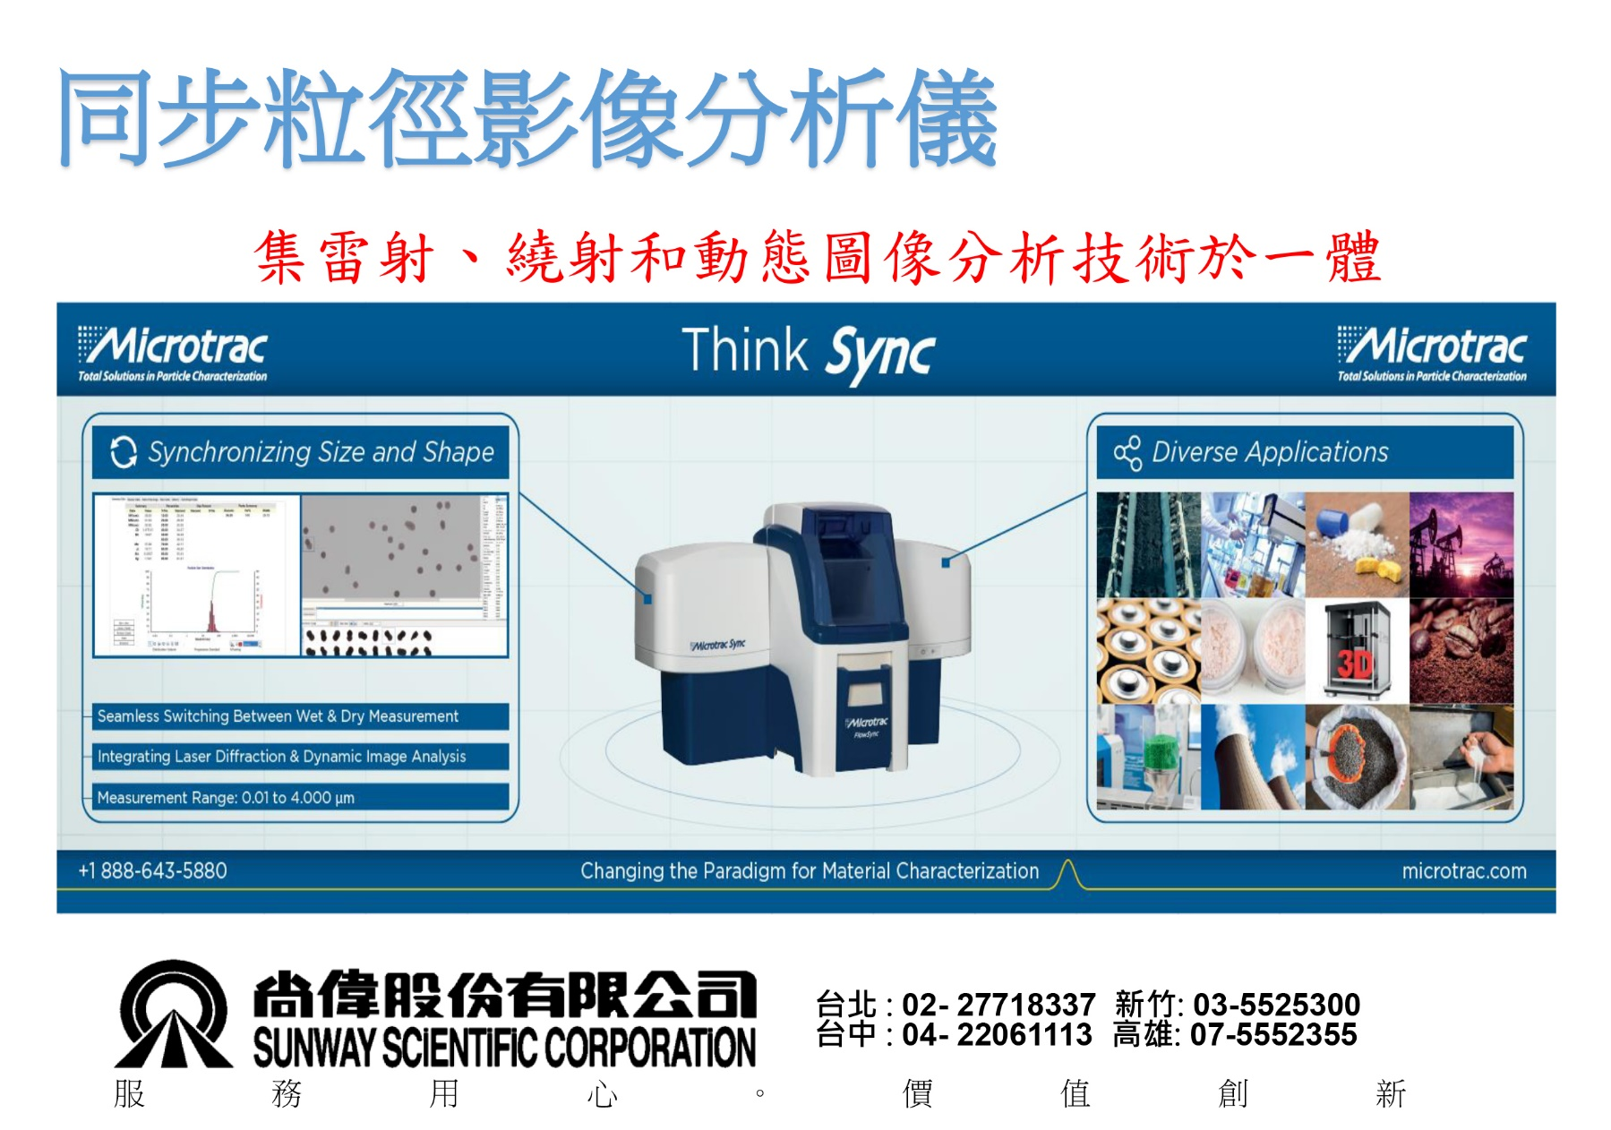

Slide 32
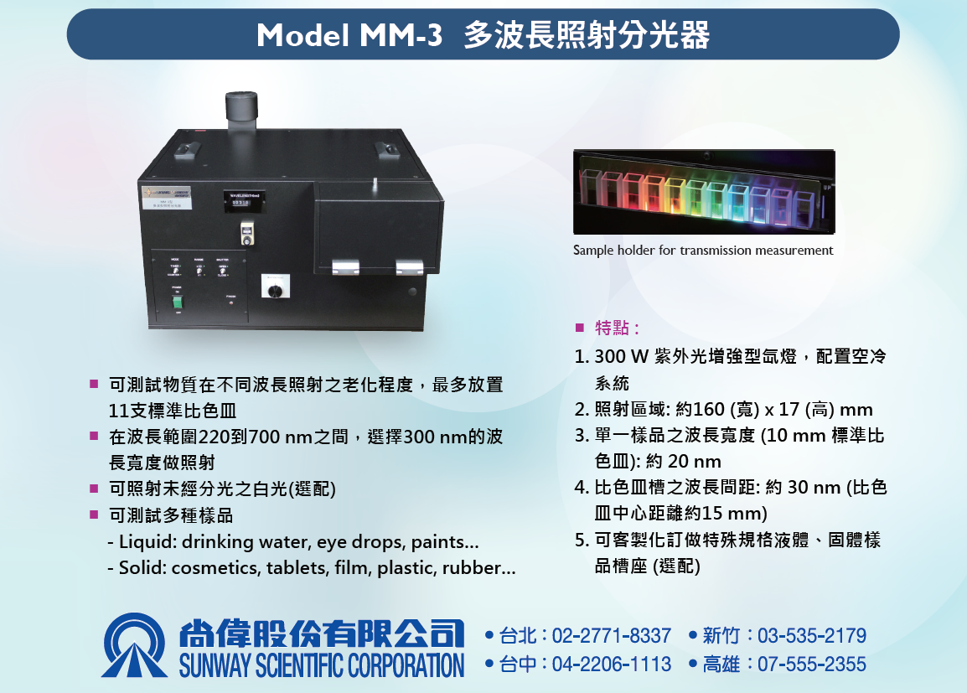

Slide 33
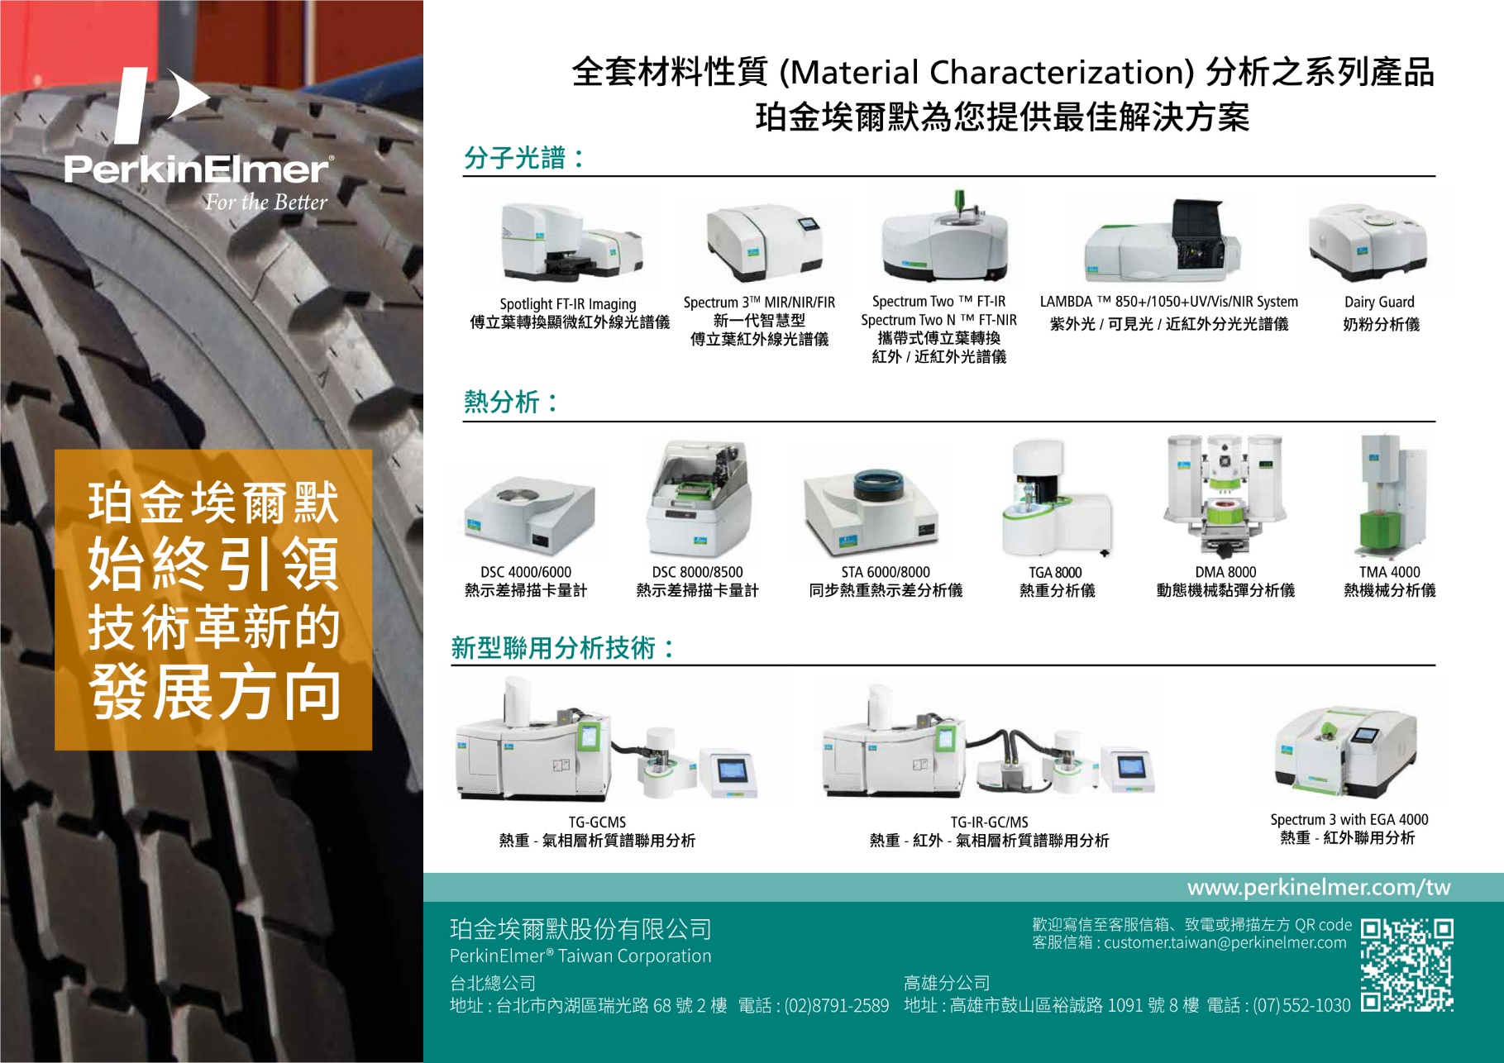

Slide 34


Slide 35


Slide 36


Slide 37


Slide 38



台北:(02)2755-2266 新竹:(03)578-2020
台中:(04)2245-2181 台南:(06)209-5135
高雄:(07)334-0407
Hitachi High-Tech
F-7100 高感度、多功能螢光分光光譜儀
具超高速掃描功能，最大60,000nm/min
解析能：1nm, Time Interval可達0.001sec
高速3D掃描功能,提供分析樣品最佳利器
內建螢光、磷光、冷光測定
特殊水平射出光束提高偵測靈敏度及減少樣品需求量
提供高能量輸出及高信號雜訊比
Hitachi High -Tech
超高解析冷場發射電子顯微鏡
倍率範圍 ： x20 To x 2,000,000
最佳解析度： 0.7 nm (1KV,SE)
Hitachi專利(SuperExB )SE-BSE信號混合模式,可以依據樣品特性,調整SE與BSE信號混合比例(0-100%) ,以達到最佳照片

Slide 39


Slide 40


Slide 42


Slide 43


Slide 44


Slide 45


Slide 46


Slide 47


Slide 48


